Slide 1
Basic Git
By :
Name : Divya Thakur
UID : 28300

Slide 2
Basic Git
Introduction to Git
Git lifecycle
Common Git command
Git Workflow
Working with Remote Repository
Version controlling using Git

Slide 3
GitHub
GitHub is a cloud-based platform where you can store, share, and work together with others to write code.
Storing your code in a "repository" on GitHub allows you to:
Showcase or share your work.
Track and manage changes to your code over time.
Let others review your code, and make suggestions to improve it.
Collaborate on a shared project, without worrying that your changes will impact the work of your collaborators before you're ready to integrate them.
Collaborative working, one of GitHub’s fundamental features, is made possible by the open-source software, Git, upon which GitHub is built.

Slide 4
Version Control System
A version control system, or VCS, tracks the history of changes as people and teams collaborate on projects together.
As developers make changes to the project, any earlier version of the project can be recovered at any time.
Developers can review project history to find out:
Which changes were made?
Who made the changes?
When were the changes made?
Why were changes needed?

Slide 5
VCSs give each contributor a unified and consistent view of a project, surfacing work that's already in progress.
Seeing a transparent history of changes, who made them, and how they contribute to the development of a project helps team members stay aligned while working independently.
In a distributed version control system, every developer has a full copy of the project and project history.
Unlike once popular centralized version control systems, DVCSs don't need a constant connection to a central repository.

Slide 6
Introduction to Git
Git is the most popular distributed version control system that intelligently tracks changes in files.
Git is commonly used for both open source and commercial software development, with significant benefits for individuals, teams and businesses.
Git is particularly useful when you and a group of people are all making changes to the same files at the same time.
Git lets developers see the entire timeline of their changes, decisions, and progression of any project in one place. From the moment they access the history of a project, the developer has all the context they need to understand it and start contributing.\
Developers work in every time zone. With a DVCS like Git, collaboration can happen any time while maintaining source code integrity. Using branches, developers can safely propose changes to production code.
Businesses using Git can break down communication barriers between teams and keep them focused on doing their best work. Plus, Git makes it possible to align experts across a business to collaborate on major projects.

Slide 7
Typically, to do Collaborative working in a Git-based workflow, you would:
Create a branch off from the main copy of files that you (and your collaborators) are working on.
Make edits to the files independently and safely on your own personal branch.
Let Git intelligently merge your specific changes back into the main copy of files, so that your changes don't impact other people's updates.
Let Git keep track of your and other people's changes, so you all stay working on the most up-to-date version of the project.

Slide 8
How do Git and GitHub work together?
When you upload files to GitHub, you'll store them in a "Git repository." This means that when you make changes (or "commits") to your files in GitHub, Git will automatically start to track and manage your changes.
There are plenty of Git-related actions that you can complete on GitHub directly in your browser, such as creating a Git repository, creating branches, and uploading and editing files.
However, most people work on their files locally (on their own computer), then continually sync these local changes—and all the related Git data—with the central "remote" repository on GitHub. There are plenty of tools that you can use to do this, such as GitHub Desktop.
Once you start to collaborate with others and all need to work on the same repository at the same time, you’ll continually:
Pull all the latest changes made by your collaborators from the remote repository on GitHub.
Push back your own changes to the same remote repository on GitHub.
Git figures out how to intelligently merge this flow of changes, and GitHub helps you manage the flow through features such as "pull requests."

Slide 9
Signing up for a new personal account
Navigate to https://github.com/.
Click Sign up.
Follow the prompts to create your personal account.
During sign up, you'll be asked to verify your email address. Without a verified email address, you won't be able to complete some basic GitHub tasks, such as creating a repository.
Now that you've created your personal account, we'll start to explore the basics of GitHub

Slide 10
Exercise : GitHub Essentials
Lets perform basic GitHub essentials like repositories, branches, commits, and pull requests.
Step 1: Create and use a repository
Step 2: Create and manage a branch
Step 3: Make changes to a file and push them to GitHub as commits (commit changes)
Step 4: Open a pull request
Step 5: Merge your pull request

Slide 11
About repositories
A repository is the most basic element of GitHub.
It's a place where you can store your code, your files, and each file's revision history.
Repositories can have multiple collaborators and can be either public or private.
Repository terminology:
Branch : A parallel version of your code that is contained within the repository, but does not affect the primary or main branch.
Clone : To download a full copy of a repository's data from GitHub.com, including all versions of every file and folder.
Fork: A new repository that shares code and visibility settings with the original "upstream" repository.
Merge: To take the changes from one branch and apply them to another.
Pull request: A request to merge changes from one branch into another.
Remote: A repository stored on GitHub, not on your computer.
Upstream: The branch on an original repository that has been forked or cloned. The corresponding branch on the cloned or forked branch is called the "downstream."

Slide 12
Step 1: Create and use a repository
You can think of a repository as a folder that contains related items, such as files, images, videos, or even other folders.
A repository usually groups together items that belong to the same "project" or thing you're working on.
Often, repositories include a README file, a file with information about your project.
README files are written in Markdown, which is an easy-to-read, easy-to-write language for formatting plain text.
GitHub lets you add a README file at the same time you create your new repository.
GitHub also offers other common options such as a license file, but you do not have to select any of them now.

Slide 13
Steps to create a repository
In the upper-right corner of any page, select , then click New repository.
In the "Repository name" box, type “any name “.
In the "Description" box, type a short description. For example, type "This repository is for practicing the GitHub Flow."
Select whether your repository will be Public or Private.
Select Add a README file.
Click Create repository.

Slide 14
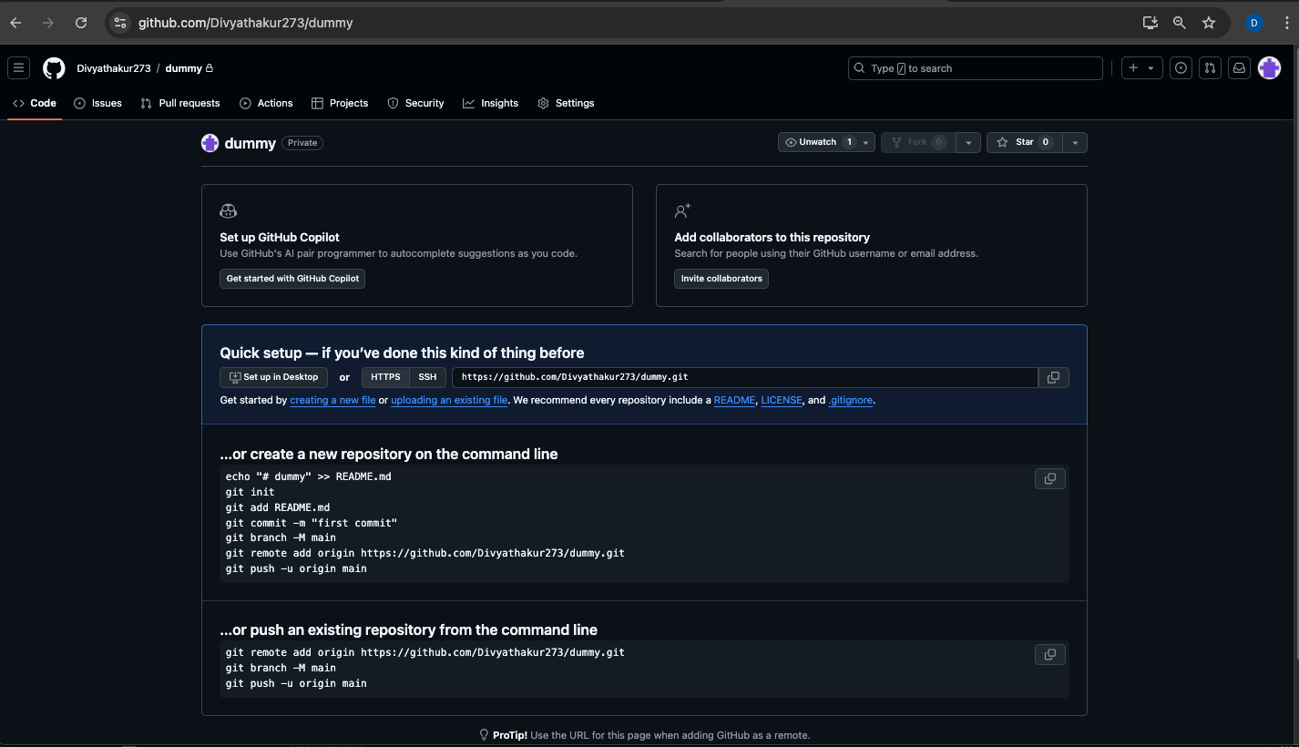

Slide 15
Step 2: Create a branch
Branching lets you have different versions of a repository at one time.
By default, your repository has one branch named main that is considered to be the definitive branch.
You can create additional branches off of main in your repository.
Branching is helpful when you want to add new features to a project without changing the main source of code.
The work done on different branches will not show up on the main branch until you merge it, which we will cover later in this guide.
You can use branches to experiment and make edits before committing them to main.
When you create a branch off the main branch, you're making a copy, or snapshot, of main as it was at that point in time. If someone else made changes to the main branch while you were working on your branch, you could pull in those updates.

Slide 16
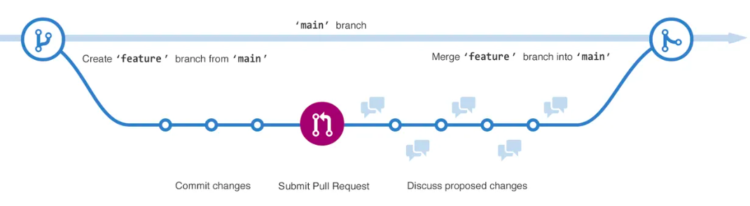
This diagram shows: 1. The main branch 2. A new branch called feature 3. The journey that feature takes before it's merged into main

Slide 17
Creating a branch
Click the Code tab of your repository.
Above the file list, click the dropdown menu that says main.
Type a branch name, “new”, into the text box.
Click Create branch: “new” from main.
Now you have two branches, main and new.
Right now, they look exactly the same.
Next you'll add changes to the “new” branch.

Slide 18
Step 3: Make and commit changes
When you created a new branch in the previous step, GitHub brought you to the code page for your new branch, which is a copy of main.
You can make and save changes to the files in your repository.
On GitHub, saved changes are called commits.
Each commit has an associated commit message, which is a description explaining why a particular change was made.
Commit messages capture the history of your changes so that other contributors can understand what you’ve done and why.

Slide 19
Under the new branch you created, click the README.md file.
To edit the file, click .
In the editor, write a bit about yourself.
Click Commit changes.
In the "Commit changes" box, write a commit message that describes your changes.
Click Commit changes.
These changes will be made only to the README file on your new branch, so now this branch contains content that's different from main.

Slide 20
Step 4: Open a pull request
Now that you have changes in a branch off of main, you can open a pull request.
Pull requests are the heart of collaboration on GitHub.
When you open a pull request, you're proposing your changes and requesting that someone review and pull in your contribution and merge them into their branch.
Pull requests show diffs, or differences, of the content from both branches. The changes, additions, and subtractions are shown in different colors.
As soon as you make a commit, you can open a pull request and start a discussion, even before the code is finished.
In this step, you'll open a pull request in your own repository and then merge it yourself. It's a great way to practise the GitHub flow before working on larger projects.

Slide 21
Click the Pull requests tab of your repository.
Click New pull request.
In the Example Comparisons box, select the branch you made, new, to compare with main (the original).
Look over your changes in the diffs on the Compare page, make sure they're what you want to submit.
Click Create pull request.
Give your pull request a title and write a brief description of your changes. You can include emojis and drag and drop images and gifs.
Click Create pull request.

Slide 22
Step 5: Merge your pull request
In this final step, you will merge your new branch into the main branch.
After you merge your pull request, the changes on your new branch will be incorporated into main.
Sometimes, a pull request may introduce changes to code that conflict with the existing code on main.
If there are any conflicts, GitHub will alert you about the conflicting code and prevent merging until the conflicts are resolved.
You can make a commit that resolves the conflicts or use comments in the pull request to discuss the conflicts with your team members.

Slide 23
Merge your branch into the main branch.
At the bottom of the pull request, click Merge pull request to merge the changes into main.
Click Confirm merge. You will receive a message that the request was successfully merged and the request was closed.
Click Delete branch. Now that your pull request is merged and your changes are on main, you can safely delete the new branch.
If you want to make more changes to your project, you can always create a new branch and repeat this process.
Click back to the Code tab of your repository to see your published changes on main.

Slide 24
Other Platforms
GitHub is an open source Git hosting platform that is available as a cloud service and as a self-hosted installation.
Similarly , we have other popular platforms as Bitbucket and gitlab , which are also open source Git hosting platform.
But the most popular platform is Github with many good features than others .

Slide 25
Difference between GIT and GitHub
Git: It is a Distributed Version Control System for tracking versions of files.
Github: It is web portal and cloud hosting service for your Git repositories.
Git uses commands to track versions of your files.
Github is just a remote platform where these files are hosted.
Git allows you to track versions of your code in your local machine.
Github :if you want a remote backup of your code or want to publish your code to a community then you've to push it to Github.

Slide 26
It's not mandatory to use Github.
If you're the sole person working on the project and don't need to publish your code to the world then you can simply avoid using Github.
Just track the versions of your code in local repository of your machine using Git.
By this point, it'd be clear that committing the code using Git in your local machine doesn't automatically upload it to Github too.
There are two distinct terms for these activities - Committing and Pushing.
Committing is capturing the changes from your working copy to your local repository. On the other hand, Pushing is uploading the captured changes from your local repository to Github.

Slide 27
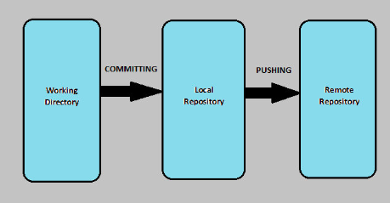

Slide 28
The Git Lifecycle
The lifecycle of Git consists of four main stages:
Create
Modify
Stage
Commit

Slide 29
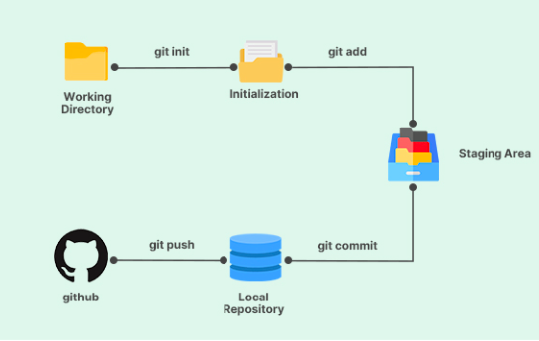

Slide 30
Create
The first stage in the lifecycle of Git is to create a new repository.
You can think of it just like a project folder.
This can be done either locally on your computer or on a remote server.
To create a new repository, you can use the command "git init" followed by the name of the repository.

Slide 31
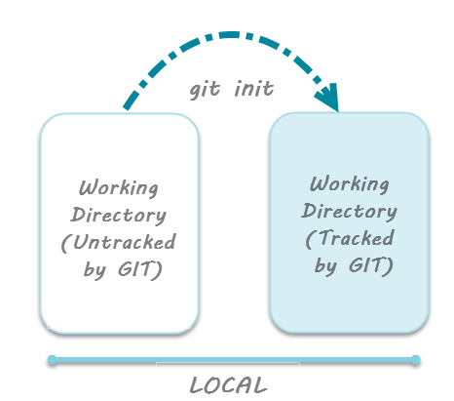

Slide 32
Modify
The next stage in the lifecycle of Git is to modify the files in the repository.
This can be done using any text editor or integrated development environment (IDE) of your choice.
When you make changes to a file, Git automatically detects those changes and marks the files as "modified."

Slide 33
Stage
The third stage in the lifecycle of Git is to stage the changes you have made.
Staging is the process of preparing your changes to be committed to the repository.
You can stage your changes using the "git add" command followed by the name of the file you want to stage.
You can also use the "git add" command to stage all changes in the repository.

Slide 34
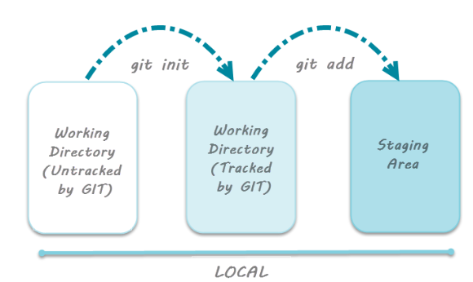
Staging area is the playground where you group, add and organize the files to be committed to Git for tracking their versions.
It's important to make a quick note of the term called indexing here. Indexing is the process of adding files to the staging area. In other words, index constitutes of files added to the staging area.

Slide 35
Commit
The final stage in the lifecycle of Git is to commit your changes to the repository.
A commit is a permanent snapshot of the changes you have made to the repository, and by default, it goes to the master branch.
When you commit your changes, Git creates a new commit object that contains the changes you have made, along with a message describing what changes were made.
To commit your changes, you can use the "git commit" command followed by a message describing the changes you have made.
Note: git commit -m"your message" - Command to commit files to Git repository with message.

Slide 36
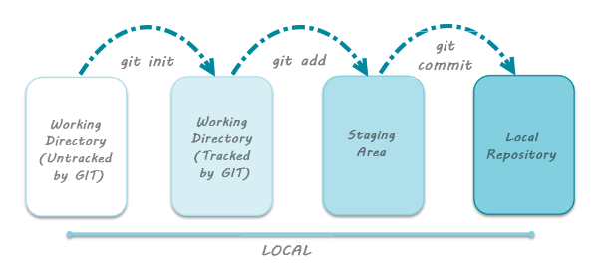

Slide 37
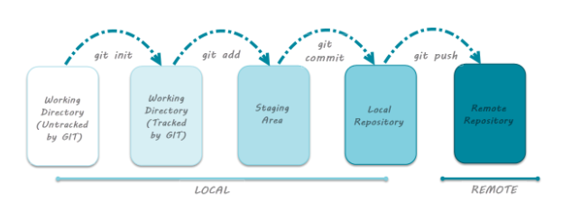
Once you have committed your changes, you can push those changes to a remote repository using the "git push" command. This will upload your changes to the remote repository, making them available for other developers to pull down and work with.

Slide 38
Need of Staging Area
Faster Git operations:
staging helps in recording the changes even before committing them to Git database.
Visualizing the commit before actual commit :
staging area is the state in which the files reside before they're committed.
That is, staging area actually lets you visualize the group of changes that will be recorded by Git.
Essentially this gives you fine-grained control over what gets committed to Git and what does not.
Splitting work into separate related commits:
suppose you're working on a new feature whose timeline of development runs into several days. So, while you're working on the feature you are required to refactor a small part of the code.
In this case, you can quickly make the required changes, stage the required file and resume work on the feature.
All of the changes i.e. feature changes and refactor code can be committed at once from the staging area.

Slide 39
GIT
Git can be used through two different methods with three different sub-methods. Both ways have their own advantages and drawbacks. Git can be used via:
Shell
GUI software

Slide 40
Git through Shell
Shell as you must have already known is used for accessing the operating system services.
Shell is used through a command-line interface.
Git can be used in two different ways on any operating system through shell.
These are:
Git Bash
Git CMD

Slide 41
Git Bash
When Git was developed it was coded in a similar way to use it on a command line.
Originally developed for the Linux Kernel project, the idea was the same originally.
Bash as you know is the terminal of any Linux OS.
Git Bash is the bash that runs the Git commands on it.
It is similar to the Unix shell with the same commands as of Linux.
You can operate git from Git Bash on any operating system.

Slide 42
Git CMD
Git CMD is used on Windows.
If you are familiar with the command prompt i.e. the shell used on Windows then you can use this one to run Git.
Git CMD is nothing but CMD which can run Git commands.
Although you can use it, the most recommended method is the Git bash.
The reason being CMD is confined to Windows only. It will confine your knowledge to Windows only.

Slide 43
Git through GUI
Git GUI is using Git with the help of a graphical interface.
This will diminish your shell usage and everything for which you were writing a command, you will now press some button or do it through the mouse.
Using Git on a shell is always preferred among the developer community.
Also, the big tech giants like Google, Amazon, etc uses Git on the command line because of its advantages and security.
Advantages including that there are some features on a shell that are not available to GUI like ssh tunnel connecting to the remote server etc.
Also, command line will let you automate your Git work.
Some features are first released to command line also before the GUI and some of them don't even release to GUI at all.
All in all, GIT on a shell is more powerful than on the GUI.

Slide 44
Git Download
Git Bash
It allows you to execute Git commands in conjunction with Unix commands in a Windows environment.
This tool will be downloaded automatically when you install GIT.
Download the git by going to the following link :
https://git-scm.com/downloads
Git cmd
It allows you to execute Git commands in a traditional Windows Command Prompt type environment.
You also get the option of selecting Git CMD while installing Git.

Slide 45
Install Git on Windows
To work on git GUI , we can download git by following link :
https://gitforwindows.org/

Slide 46
Git Commands
git help:
This command will display all the information about Git.
If we need to see all the available commands in Git, we need to use the following command.
git help -a or git help --a or git help --all
git help -g : This command gives common git guides.
git help <guide_name> : This command gives manual page of specific guide.
git help <command name> : This command gives information about a specific command .

Slide 47
Set Up Default Credentials for Git Config
vi ~/.gitconfig : Command to check the personal configuration settings.
As we install Git in our system, the configuration file takes default values for some of the fields.
This creates a conflict in the identity of the programmer.
We will Set Up Default Credentials for Git Config , so that no random credentials are set by default .
You will not get any value if you have not already set it.

Slide 48
Set user's UserName in Git Config:
git config --global user.name "Your UserName"
eg :
git config --global user.name "Divya Thakur"
To confirm :
git config --global user.name
Set user's Email in Git Config:
git config --global user.email "Your EmailID"
eg :
git config --global user.email "divyathakurdt73@gmail.com"
To confirm :
git config --global user.email

Slide 49
View the complete list of setting in Git Config:
git config --list
The below command will be used to set a default editor for gitbash for eg notepad++ for windows .
git config --global core.editor <directory address>

Slide 50
How to create repository in cli
cd <path of the directory> :
Changing the directory is important as you are always shuffling between different directories all the time while working with Git Bash.
Directory is a technical term for the folder.
Create a New Directory:
mkdir <folder name>
Create Bare Git Repository(empty directory with just a hidden .git folder):
Create a New Project/Folder (using mkdir)
Browse to New Project(using cd)
Initialize Git Repository for the Project : git init
git init is a standard GIT command and it initializes the directory with a .git folder used for tracking versions of project artifacts.

Slide 51
.git
ls -a : command used to see the hidden files in a directory.
Contents of .git folder :
Hooks:This folder has a few script files inside it. These script files are known as Git Hook Scripts. Git hooks are the scripts that are executed before or after the events. These events can be any Git event including the common Git events like commit, push, or receive.
Info: Info folder contains the exclude file inside it. As the name suggests, exclude file is used for excluding some specific patterns in the code that you don't want Git to read or execute. (.gitignore)
Objects
Config :The config file contains your configuration
Description:Description contains the data about the repositories which can be seen on GitWeb only.It is a web-based visualizer. Git comes with a CGI script called GitWeb.
HEAD

Slide 52
Objects:
Objects folder is a very important folder in the .git directory.
In Git, everything is saved in the objects folder as a hash value.
By everything I mean every commit, every tree or every file that you create is saved in this directory.
With every object, there is a hash value linked to it, through which Git knows where is what.
The folders are created accordingly.
example :
1.) create a file in repsitory .check the object folder .
2.) Add some text to this file with command : echo "this is my first file" > filename.txt
3.)Add your file to the staging area : git add filename.txt
4.)Commit the changes : git commit -m "Committing my Changes"
These contain the hash value of the events you just did. Git tracks and recognizes everything by converting it to the hash value. The folders are named according to the hash value saved inside.
hashing is a popular method (data structure) of converting your data to hash value (random combinations of letters and digits) .
Hashing in Git is used to be able to trust and create stable data where collision does not occur which means two same files can be saved because they will have different hash values

Slide 53
Head: Head file contains the reference to the branch we are currently working on.
It is a symbolic reference to the branch and not the normal reference.
The difference being that the normal reference contains the Hash value as we saw in the above Objects folder.
It refers to something directly like pointers in programming.
To see the content of the Head file you can just type the command:
cat .git/HEAD

Slide 54
Deleting .git Folder
Deleting this folder will delete our entire history.
If you haven't cloned it, all the version and history is erased from Git.
Though your source file will remain as it is.
To delete the .git folder, just go to Git Bash and delete the folder by typing the command:
rm -rf .git

Slide 55
Git Staging
Git Add Command
Git Status Command
Git Remove Command
Lets discuss them one by one in detail.

Slide 56
Git Status Command
It returns information about the current state of the repository.
For e.g. a list of files changed, list of tracked changes on staging, untracked changes on local, and information about current branch & commits.
Staging Area: Git has the concept of a staging area, where all the updates/changes are tracked. This holds the changes which you would like to commit. Changes can be a single line, files, or parts of files.
Untracked Changes: Changes/files on the local directory and which are not pushed to staging are known as untracked changes.
Tracked Changes: Changes/files on staging are known as tracked changes.
Type git status in the command prompt. This will now list which files are staged, unstaged, and untracked.

Slide 57
Git add
The git add command adds a change in the working directory to the Staging Area.
It tells Git that there are few updates in the project, which the user wants to commit next.
The thing here to note is that git add doesn't affect the remote repository, as changes are not actually recorded until you perform git commit.
Create a file inside repo using : touch filename.txt
enter data in the file : echo “this is my first file”>filename.txt
Check the data in the file : cat filename.txt
write “ git add “ command in cli
see git status using “git status “ command .
O/P :
Changes to be committed: This shows the information of tracked files kept on staging. This is the one, which we added using git add command.
Untracked files: This shows the information of untracked files. These are the ones, which brought to the project earlier but still not pushed to staging.

Slide 58
To add multiple file to staging area:
git add <filename> <filename>
To add all file to staging area at once :
git add *
Git remove
git rm:
The git rm command removes tracked changes from the Staging Area.
It tells Git that the updates which were pushed to staging earlier with git add command, are not ready to commit
git rm --cached <file> : command used to remove file .
To remove multiple file : git rm --cached <file> <file> .

Slide 59
O/P parameters of git status
branch master: This says that the working tree is a master branch. no
commits yet: This gives information on the commits, as of now there are no commits yet.
Untracked files: This says that Git sees the files but has not started tracking changes yet and marked these as red.
Status messages: This gives relevant instructions for staging/unstaging files.

Slide 60
Git Commit
Committing the changes in Git:
git commit
Committing the changes in Git without commit message:
git commit -m “this is my first commit”
Git does not recommend to commit without any message.
Git commit messages are necessary to look back and see the changes made during a particular commit.
If everyone will just commit without any message, no one would ever know what changes a developer has done.
Commiting without a message :
git commit -a --allow-empty-message -m "message"

Slide 61
Rename a file in git :
git mv <original_file_name> <new_file_name>

Slide 62
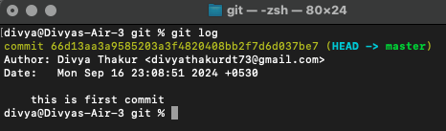
Inspect & Track Changes
git status : command used to insoect changes made
git log :
Git log is a command used in Git to access the history of commits that the repository has gone through.
It captures all the changes happening inside the repository
Output :
Commit Hash: The first part of the commit log is "commit hash" which is the hash value by which Git saves or refers everything internally.
Commit Author: This part tells you about who committed the changes in the repository i.e. the author name.
Commit Date: This part shows you the date and time of the commit with the day and time zone. It is important to have a day and time zone because many people work on a single project from different geographical locations.
Commit Message: This part shows the commit message that was written while committing the changes.

Slide 63

git log --oneline:
As you can see some of the details that were previously visible are now hidden and the view is of only one-liner.
Commit Id: Every commit has a commit id which is actually a compressed version of commit hash. Since a commit hash is not a sequential number, compressing it still shows unique commits.
Commit Message: commit message to understand what the commit was about.

Slide 64

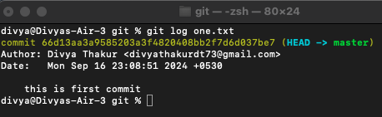
git log <commit hash>
see the log details using the commit hash that we have got from git log --oneline command .
Output:
git log <filename>: used to get logs using filename:

Slide 65
View Commits History for a range:
git log <since commitId>..<until commitId> :
Since means, the last commit up to which you want to see.
Until means, the latest commit that you would like to see.
We see reverse chronological order in Git and not normal chronological order.
git log --reverse : See the chronological order
limited number of Git Commits History:
git log -n 2 -oneline : (issue last 2 git commits)
Git Diff Command
Diff command is used in git to track the difference between the changes made on a file.
Diff command takes two inputs and reflects the differences between them before commit.

Slide 66
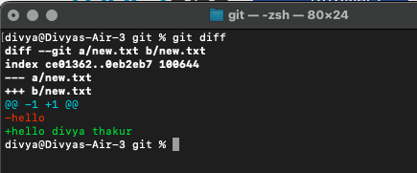
Git Diff Command output :
The first line shows the file names that have been considered as the input in git diff. You can see that they have been marked by a and b along with the two different file state that has been taken as input.
This shows the metadata related to the command and the execution of it on the files.
This line defines the symbol, called a legend, to tell you what is used to describe the first file and what is used to describe the second file. As you can see, - is used in front of the first file, and + is used in front of the second file. So whenever diff shows you the changes related to the first file, they will be marked by - and the changes in the second file will be marked by the symbol +.
The fourth line shows you symbol @@ and symbols ahead of it. They are called chunks. Chunks in git diff define the change' summary. In our image the following chunk can be seen @@ -1,2 +1 @@
This means that lines one and two were changed in the first file and line one was changed in the second file. Remember the - and + symbol used in the third point as a symbol to the first and second file respectively.

Slide 67
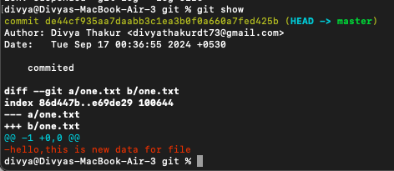
Git Show command
Git show is similar to git log ,the only difference is that with logs it shows :
Difference between the versions of the file to which HEAD is pointing (diff)
Output:
git log --author=Divya : to see logs of specific author

Slide 68
Connecting a Git local repository with GitHub remote repository.
A git remote command is used to make the remote connections such as connecting a Git local repository with GitHub remote repository.
Git remote is just a connection between the local and GitHub repository.
git remote can be considered as a reference to the GitHub repositories which do not provide any real-time access to what you do locally i.e. whatever you do locally will not be reflected on your GitHub repository without your permission.
Git remote can be used to connect to your own repository or to connect to someone else's repository.

Slide 69
git remote add name command :
git remote add origin https://github.com/Divyathakur273/devops.git
The above command follows the generic syntax of git remote add <name> <repository url>
Add: To add a new URL to the repository.
Name: To give a name that you will use instead of the URL of the repository.
URL: The URL of the repository.
To check whether we linked our repository or not, execute the git remote command.It will show you that the origin repository (alias for the GitHub myFirstRepo repository) is available.
git remote -v command : show you the url of origin repo .
git remote rm <name> : to remove a connection , in the above scenario name is origin.
git remote rename <old-name> <new-name> : change name of old repo .

Slide 70
git fetch : The git fetch command downloads commits, files, and refs from a remote repository into your local repo.
Scenario :
1. git remote add new https://github.com/Divyathakur273/devops.git
2. git remote -v
3. git branch -r :to see branches
4. git fetch new : fetch the refs from new .
git fetch new <branch name>
git fetch --all
5. git branch -r
6. git log new/main: check the logs of all branches.
git fetch has similar behavior to git pull, however, git fetch can be considered a safer, nondestructive version.

Slide 71
Git fork
A fork is a copy of a repository. Forking a repository allows to freely experiment with changes without affecting the original project.
When a user forks a repository, all the files in the repository are automatically copied to the user's account on GitHub and it feels like the user's own repository.
This process is similar to copying a folder from one drive to another drive on a computer.
Through git forking, the users can develop their own modifications to the code that belongs to someone else.
To be noted, that this process does not have any effect on the original repository (also called an upstream repository) code.
Forking a repository on GitHub is done for two main purposes:
Improving someone's code/software
Reusing the code in a project
Forking is allowed for public repositories without permission. But if the repository is private, one can only be able to fork if he or she has permission from the owner of the repository.

Slide 72
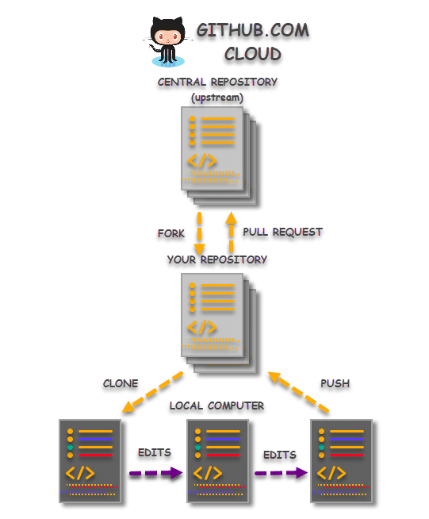

Slide 73
Cloning a Remote Repository from GitHub
Cloning is a process of creating an identical copy of a Git Remote Repository to the local machine.
A repository that is uploaded online for collaboration is called an Upstream Repository or a Central Repository.
A central repository indicates that all the changes from all the contributors pushed into this repository only. So, this is the most updated repository instance of itself. Sometimes this is often called the original repository.

Slide 74
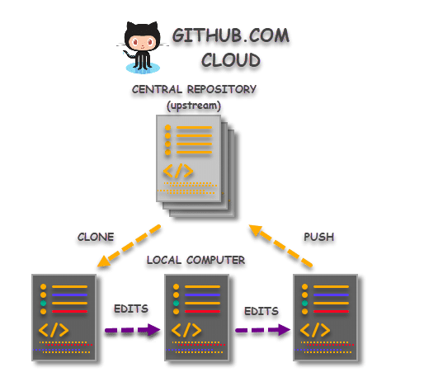

Slide 75
git clone <repoURL>
It is a standard GIT command to clone an existing remote repository.

Slide 76
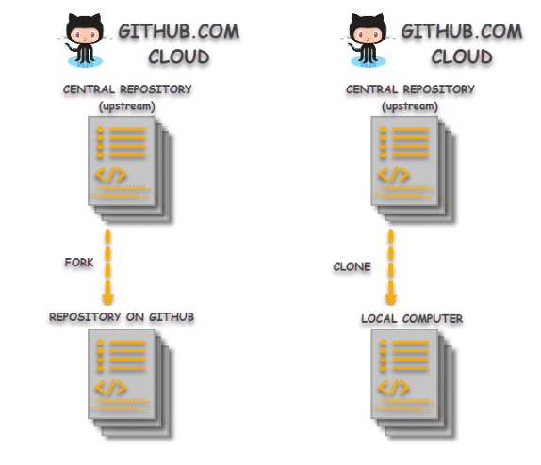
Difference btw git clone and git fork

Slide 77
git push
A git push command, when executed, pushes the changes that the user has made on the local machine to the remote repository.
To be able to push to your remote repository, you must ascertain that all your changes to the local repository are committed.
Consider Git push as a part of the synchronization process in Git.
The synchronization happens between the local and remote repository where the source and the receiver may vary.
It uploads the changes done on the local repository to keep the remote repository up to date.
command : git push

Slide 78
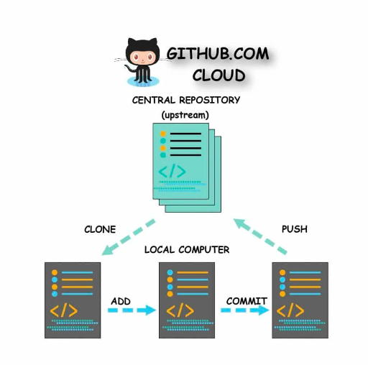

Slide 79
command :
git push <remote_repo> <branch_name>

Slide 80
Blob
Git represents your file’s contents in blobs, which are also leaf nodes in something close to a directory, called a tree.
A Git blob (binary large object) is the object type used to store the contents of each file in a repository.
The file's SHA-1 hash is computed and stored in the blob object.
These endpoints allow you to read and write blob objects to your Git database on GitHub.
Blobs leverage these custom media types.

Slide 81
git cat-file -p 21a40280c2ce1d4cdd0e6590f154479da9837495
Here the command is git cat-file -p hashvalue
21 is the folder inside which the hash is there
and a40280c2ce1d4cdd0e6590f154479da9837495 is the actual hash
to check the data of the file through hash
git cat-file -t 21a40280c2ce1d4cdd0e6590f154479da9837495
Command to check the type of file ie, blob, tree etc

Slide 82
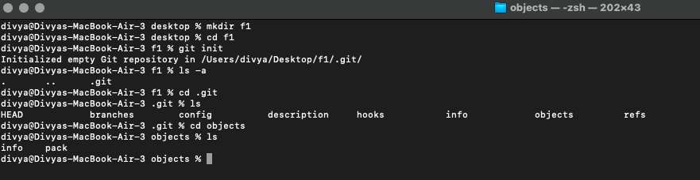
Step by step directions: Step 1:

Slide 83
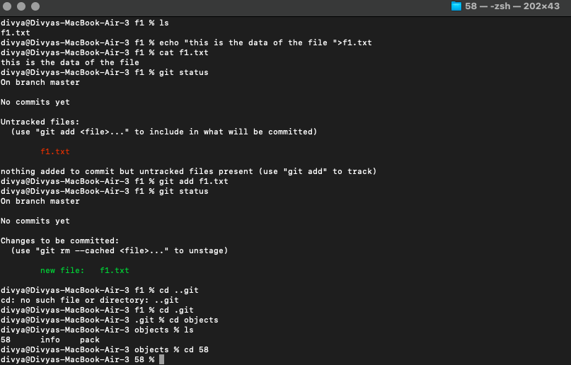
Step 2: Adding file to the staging area

Slide 84
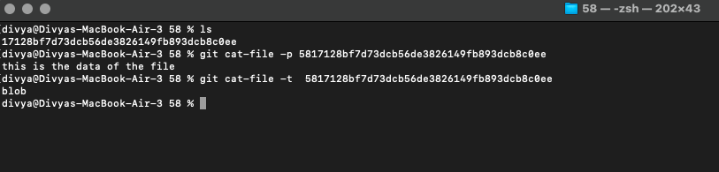
Step 2:

Slide 85
Step 3 : from staging to commit
Now , in step 2 , before commit , we have got one file in objects i.e, 58 , which contains hash value of the data inside the file f1.txt , which we created .
We have only added the file to the staging area and not commited yet .
In step 3 , we will add the file to the commit and then in the object folder , 2 new files will appear in which one file will contain hash value of commit and other will contain tree.

Slide 86
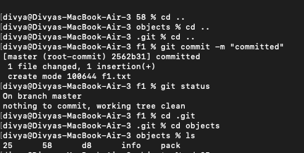
Step 3 : commit of file f1.txt

Slide 87
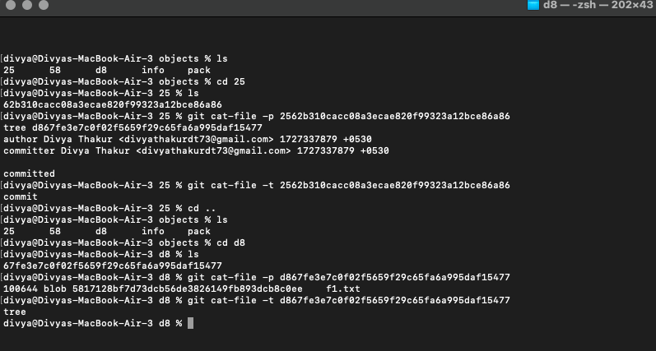
After committing , new files created are 25,d8

Slide 88
Mktree and read tree
Mktree : used to create a tree
git cat-file | git mktree
Read tree: To read the contents of the tree.
git read-tree <hashvalue>

